Slide 1


MEN’S CRICKET
WORLD CUP 2023
Presented by:
G.Guru Charan
MIP-ML-08

Slide 2

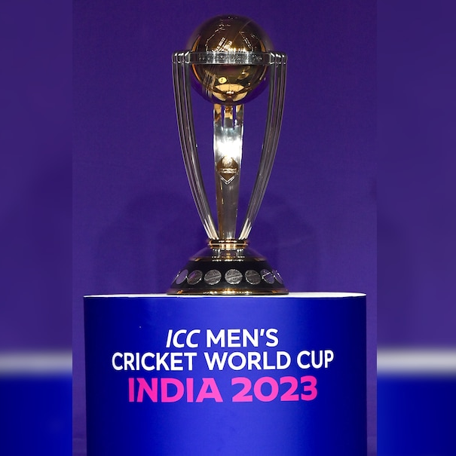
Introduction
The World Cup 2023 Data Analysis project looks at how well teams and players performed in the tournament. It checks things like how many runs were scored, how many wickets were taken, and how performance changed over time. By analyzing this data, we can understand more about cricket and how teams and players did in the tournament

Slide 3
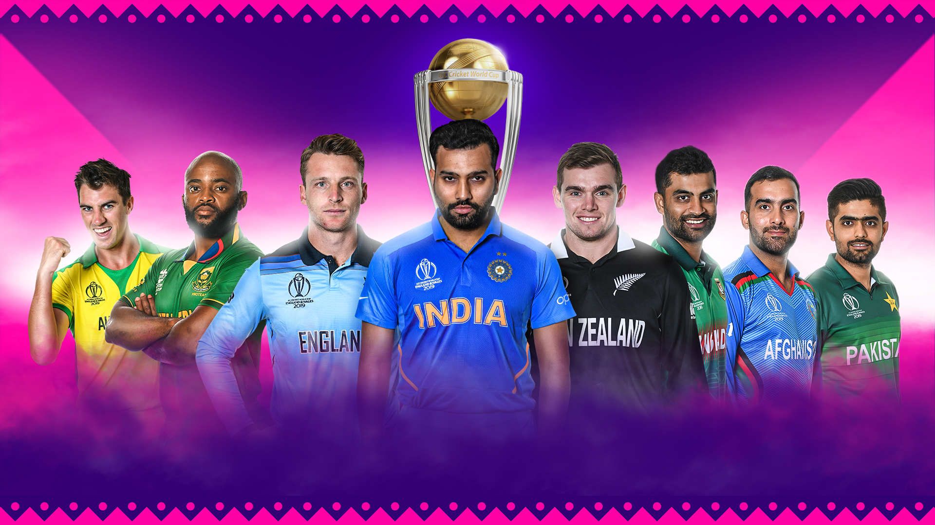
World Cup 2023 Overview

Slide 4
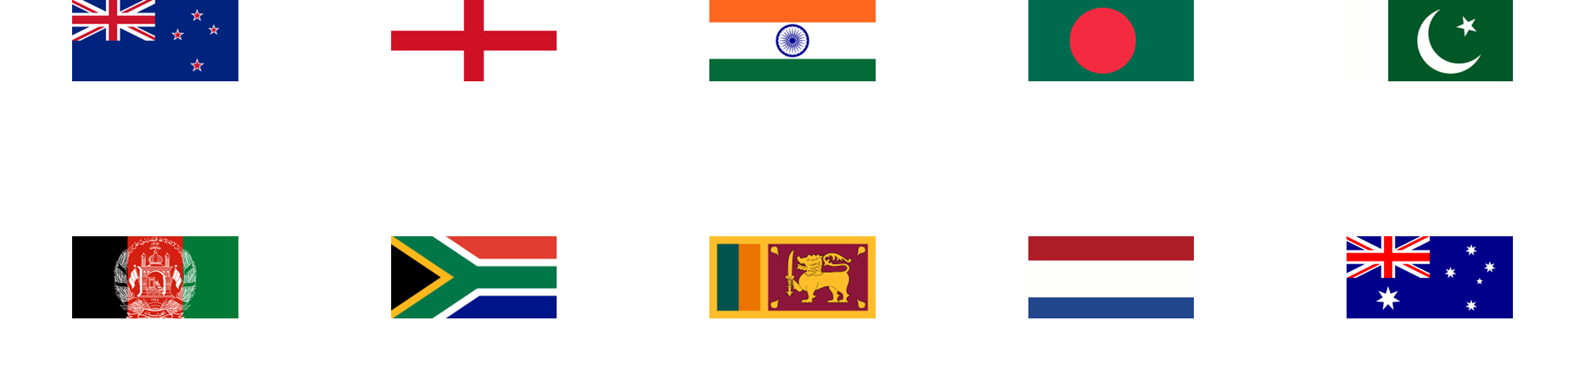
ICC World Cup 2023 Team List

Slide 5

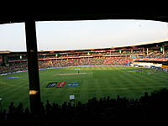
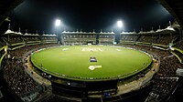
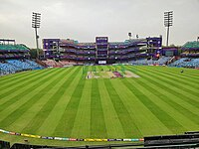
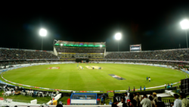
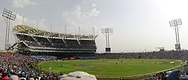
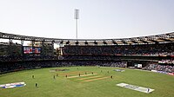
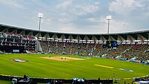
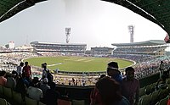
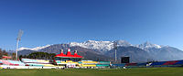
Venues
Ahmedabad,
Narendra Modi Stadium
Matches: 5 (including final)
Bangalore,
M. Chinnaswamy Stadium
Matches: 5
Chennai,
M. A. Chidambaram Stadium
Matches: 5
Delhi,
Arun Jaitley Stadium
Matches: 5
Hyderabad,
Rajiv Gandhi International Cricket Stadium
Matches: 3
Pune,
Maharashtra Cricket Association Stadium
Matches: 5
Mumbai,
Wankhede Stadium
Matches: 5 (including semi-final)
Lucknow,
BRSABV Ekana Cricket Stadium
Matches: 5
Kolkata,
Eden Gardens
Matches: 5 (including semi-final)
Dharamshala,
HPCA Stadium
Matches: 5

Slide 6
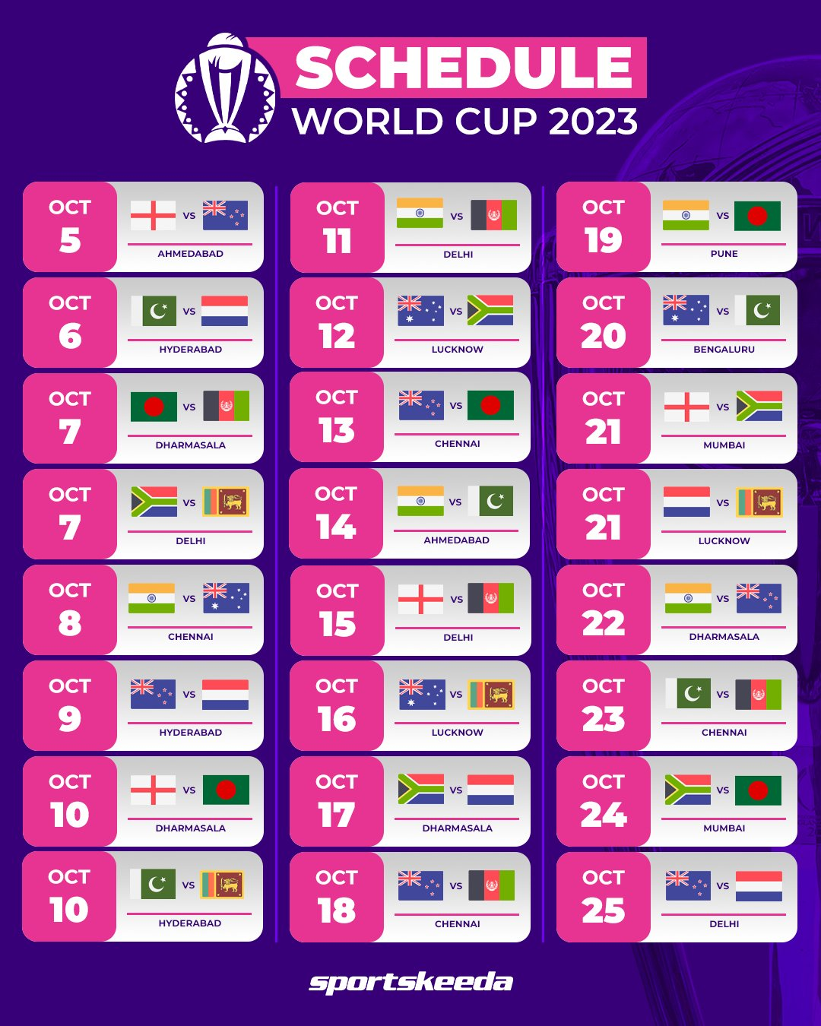
Match Schedule

Slide 7
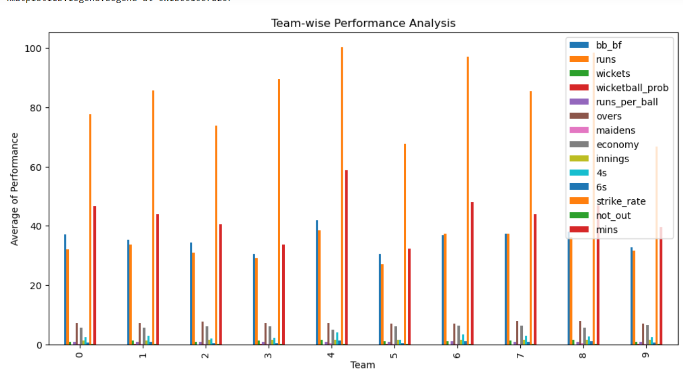
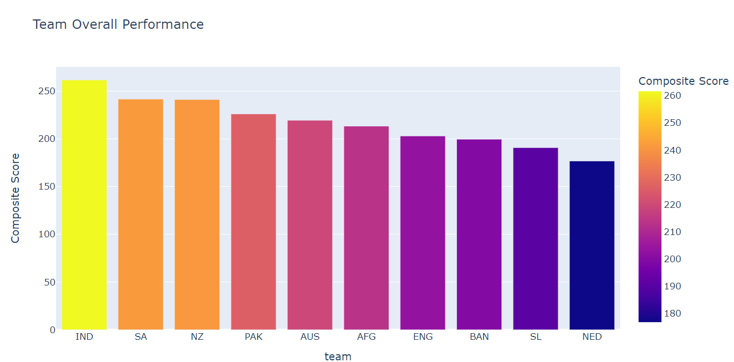
Team-wise Analysis
In this team wise analysis we can see the performance of all the teams participating in the World Cup 2023 with respect to each and every factor
Team-Overall Performance
In this Team Overall Performance Analysis we can see the performance of all the teams participating in the World Cup 2023 across the Matches.

Slide 8
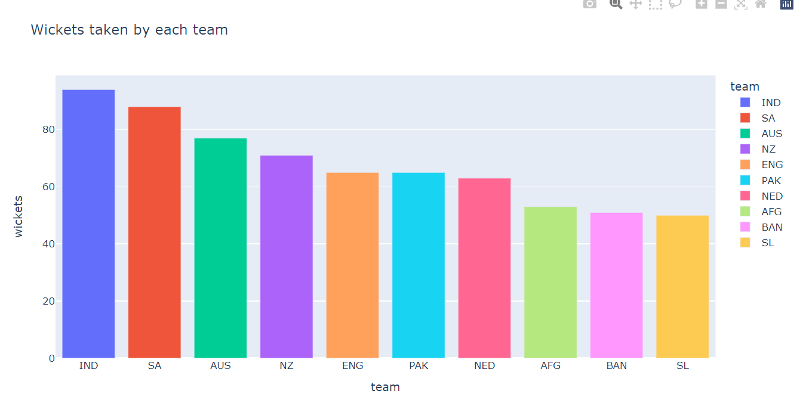
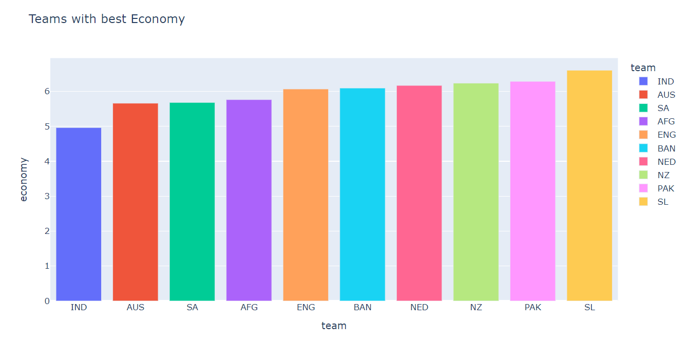
The plot shows the No. of Wickets taken by each team in the World Cup 2023We can see that most Number of Wickets were taken by India in the whole Finale.
The plot shows the Teams with Highest Economy for participating in the World Cup Tournament.

Slide 9
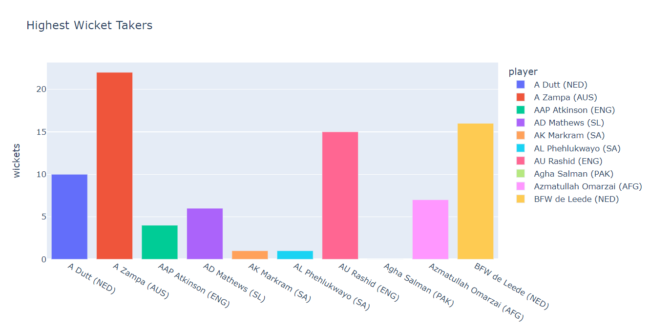
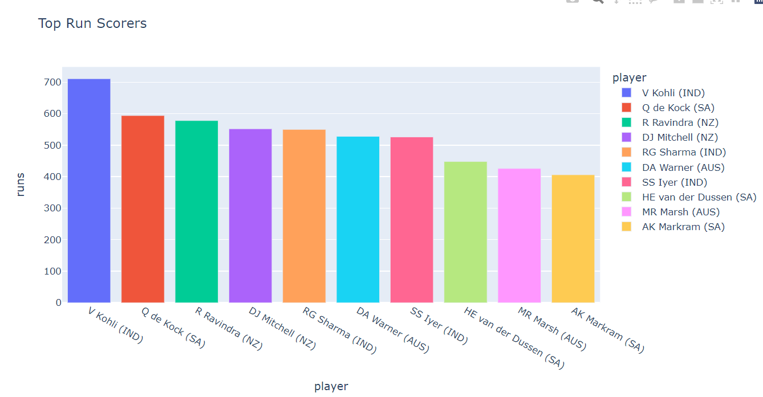
We can see that most Number of Wickets in the World Cup 2023 were taken by A. Zampa (An Australian Bowler) in the whole season
The Top 10 run Scorers of the Season are
Virat Kohli
Q de Kock
R Ravindra
RG Sharma
DA Warner

Slide 10

Conclusion
Team New Zealand showcased impressive batting prowess, while Team South Africa demonstrated formidable bowling strength.
Top performers like R Ravindra (NZ), V Kohli (IND), and GJ Maxwell (AUS) excelled in run-scoring, while A Zampa (AUS), BFW de Leede (NED), and M Jansen (SA) dominated in wicket-taking.
This analysis provides a comprehensive understanding of team dynamics, contributing to enhanced performance in competitive cricket

Slide 11
Thank You

